Slide 1
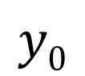
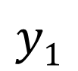
Fully Connected Neural Network
Layer 1
Layer 2
Layer 3
3 layers
Neuron
x₁
$$y0$$
x₂
$$y1$$
x₃
Input Layer
Hidden Layer
Output Layer

Slide 2

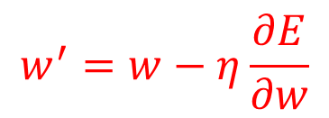

Feedforward and Backpropagation
Layer 1
Layer L-1
Layer L
$$σ$$
$$∑$$
$$w^{′}=w−η\frac{∂E}{∂w}$$
Learning

Slide 3
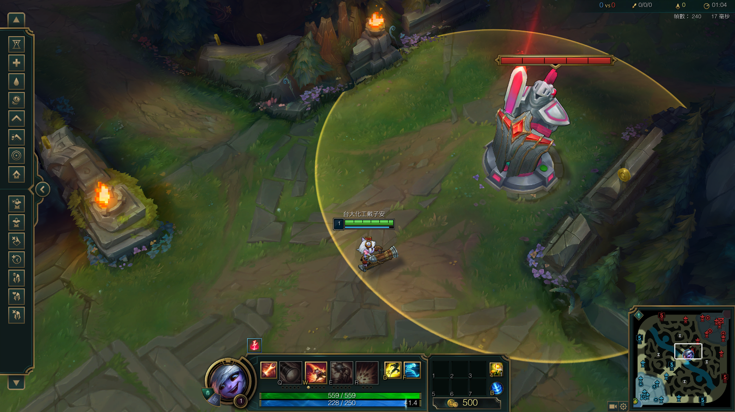
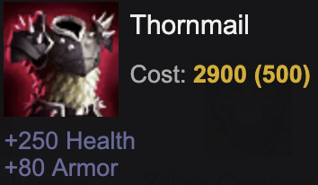
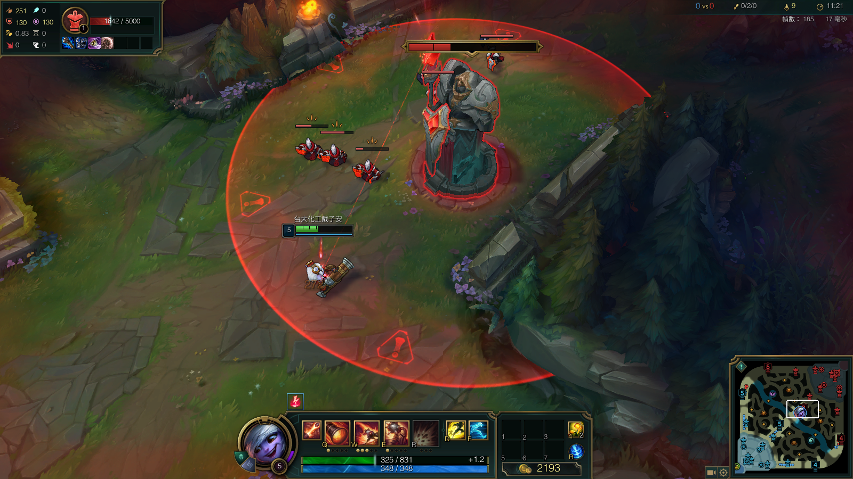
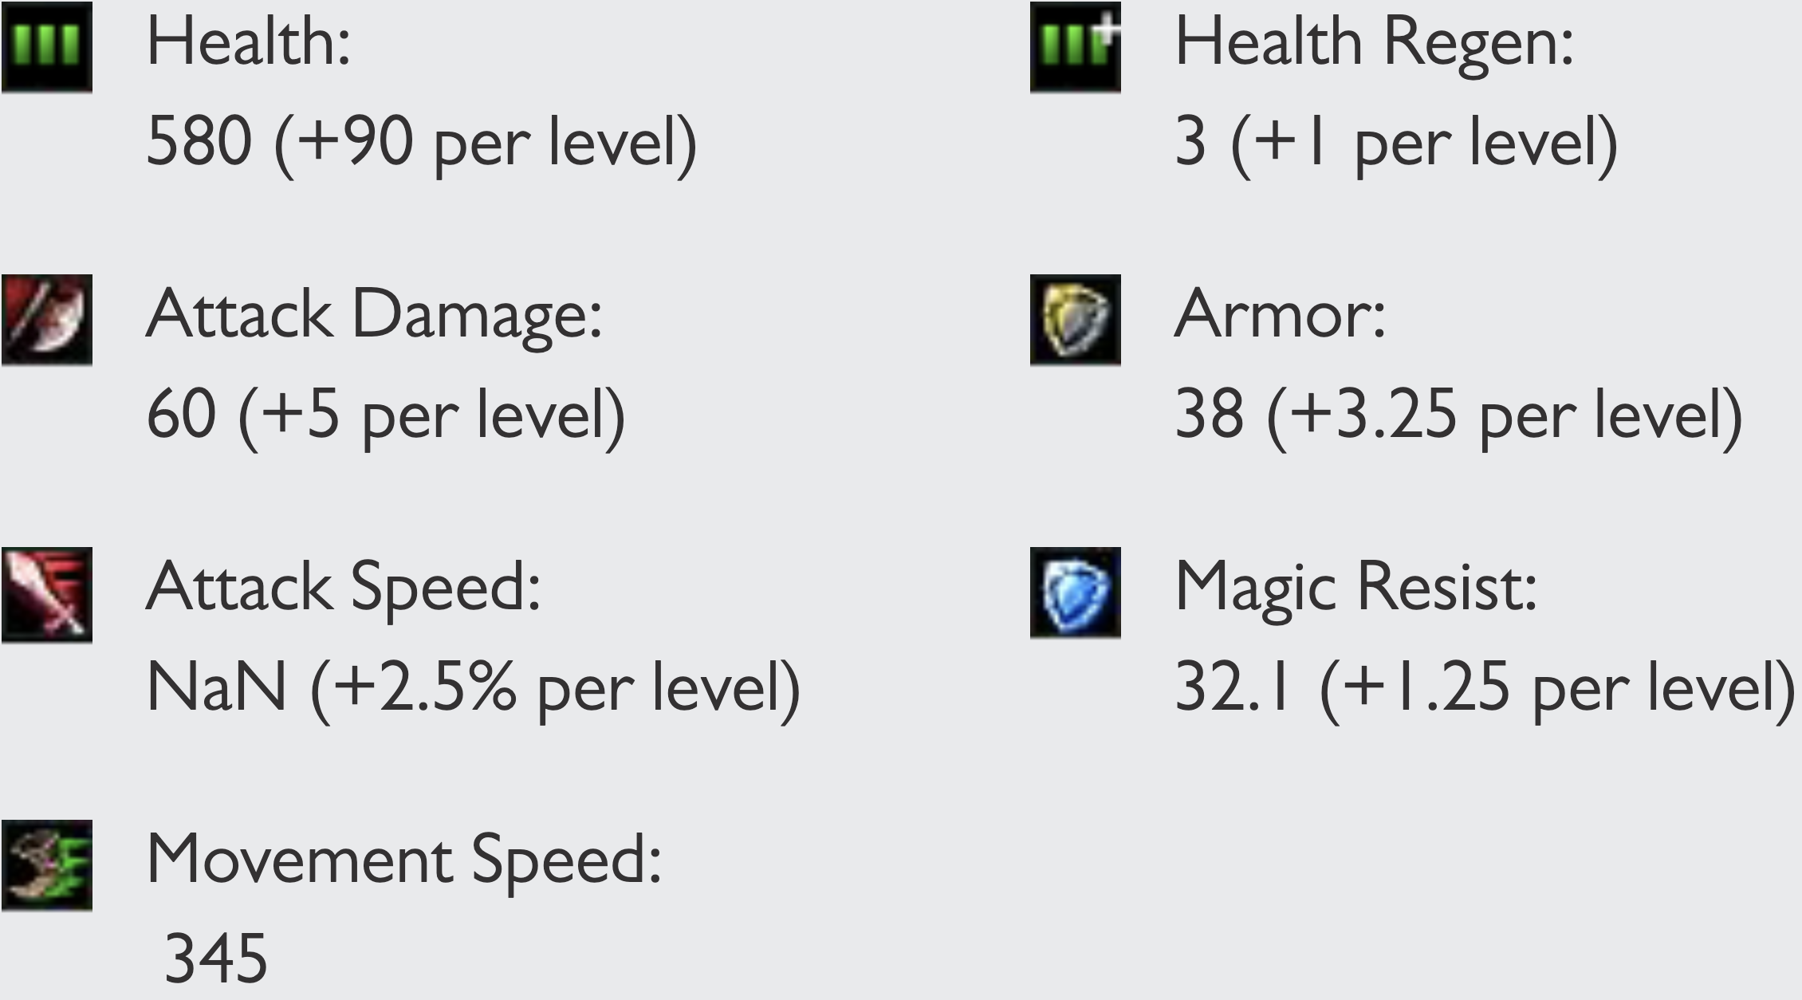
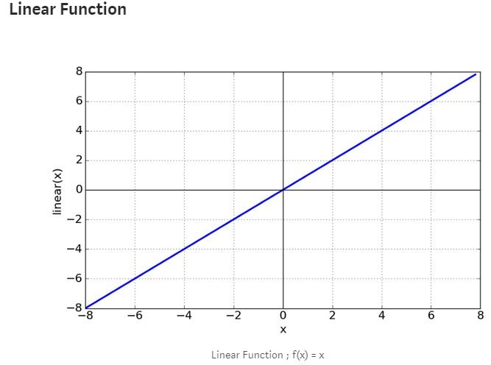

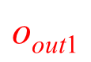
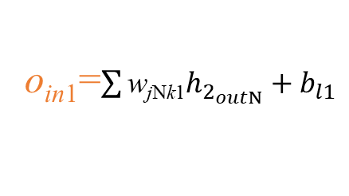
Regression
Lv
Loss=???
𝜎 = Linear function
Turret damage
$$\text{o}\text{out}\text{1}$$
$$\text{o}\text{out}\text{1}=\text{o}\text{in}\text{1}$$
o_{in1}=$\sum{\text{w}\text{j}\text{N}\text{k}\text{1}h_{2_{outN}}}+b_{l1}$

Slide 4
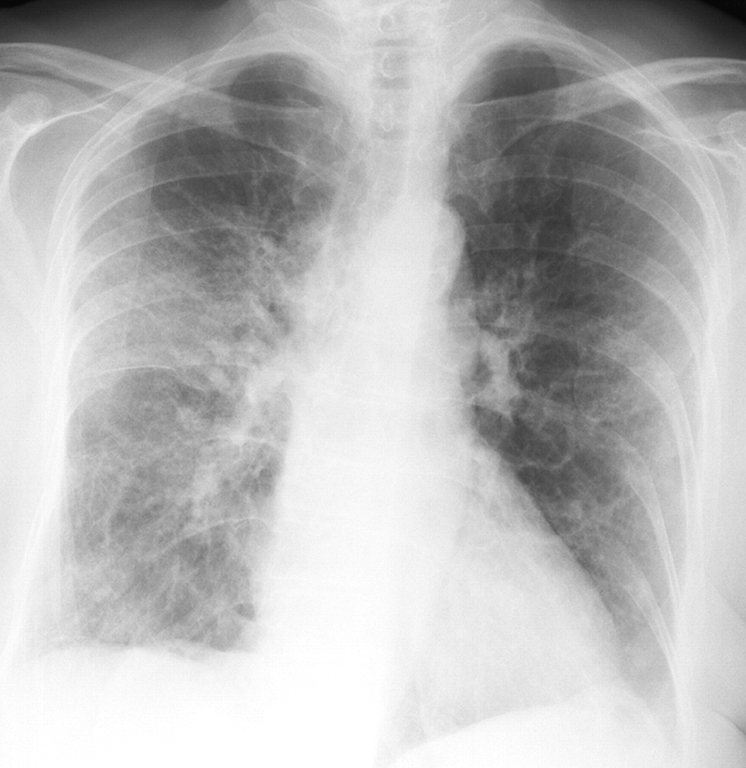






Classification
Binary Classification Problem
- Only one right answer
Categories = 2 | Binary Classification
Positive [1] Negative [0]
Multi-Label Classification Problem
-More than one right answer
-Non-exclusive outputs
Multi-Class Classification Problem
-Only one right answer
-Mutually exclusive outputs
[0]
[1]
Categories = 6 | Multilabel Classification | Multiclass Classification (Single Label)
Assassin [1 0 0 0 0 0] Tank [0 1 0 0 0 0] Mage [0 0 1 0 0 0] Support [0 0 0 1 0 0] Fighter [0 0 0 0 1 0] Marksman [0 0 0 0 0 1]
[0 1 1 0 0 0]
[0 0 0 1 0 1]
[1 0 0 0 1 0]
[1 0 0 0 0 0]
[0 0 1 0 0 0]
[0 0 0 0 0 1]

Slide 5








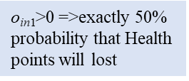
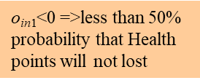
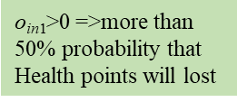
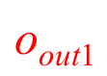
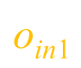
Binary Classification
Health points lost?
Yes
or
Sigmoid
No
$$\text{o}\text{out}\text{1}$$
$\text{o}\text{in}\text{1}\text{>0 =>}$more than 50% probability that Health points will lost
$\text{o}\text{in}\text{1}\text{<}\text{0 =>}$less than 50% probability that Health points will not lost
$\text{o}\text{in}\text{1}\text{>0 =>}$exactly 50% probability that Health points will lost
$$\text{o}\text{in}\text{1}$$

Slide 6
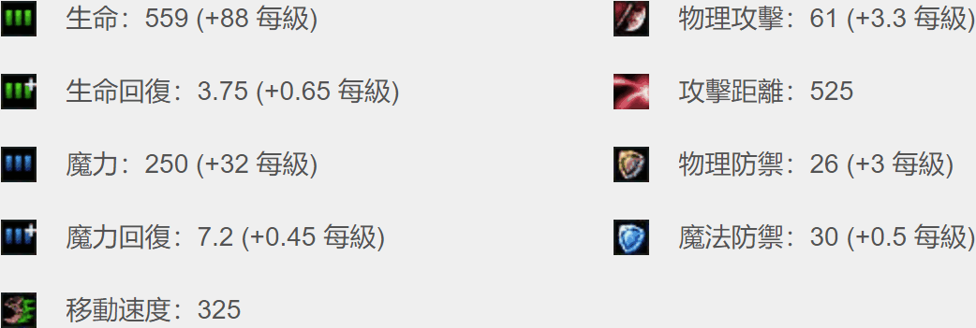

Multilabel Classification Problem
Assassin (0.66)
Tank (0.11)
Mage (0.13)
Support (0.35)
Fighter (0.21)
Marksman (0.79)
Sigmoid

Slide 7
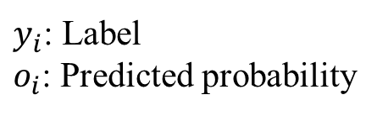
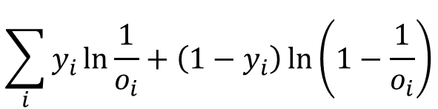
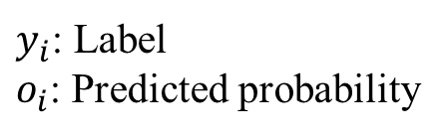
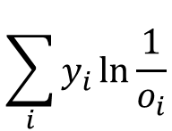
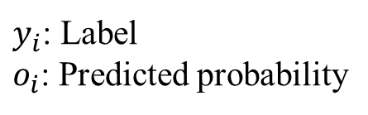
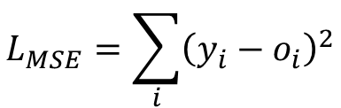
Loss Function
Problem type | Last-layer activation | Loss function (Error)
Binary classification | sigmoid | binary_crossentropy
Multilabel classification | sigmoid | binary_crossentropy
Multiclass classification | softmax | categorical_crossentropy
Regression | none | mse
Binary Cross-entropy
Categorical Cross-entropy
Mean Square Error (MSE)
$$\sum_{i}{y_{i}\ln{\frac{1}{o_{i}}+\left(1−y_{i}\right)\ln\left(1−\frac{1}{o_{i}}\right)}}$$
$$\sum_{i}{y_{i}\ln{\frac{1}{o_{i}}}}$$
$$L_{MSE}=\sum_{i}{{\left(y_{i}−o_{i}\right)}^{2}}$$
$y_{i}$: Label
$o_{i}$: Predicted probability
$y_{i}$: Label
$o_{i}$: Predicted probability
$y_{i}$: Label
$o_{i}$: Predicted probability

Slide 8
Model Evaluation Metrics
Metric: Used to judge the performance of your model. This is only for user to look at and has nothing to do with the optimization process
Regression problems: Mean Absolute Error (MAE), Mean Squared Error (MSE), Root Mean Squared Error (RMSE)
Classification problems: Accuracy, Precision, Recall, F1-score, ROC, AUC, …
Note: The loss function is used to optimize your model. It is designed to be easy to take the derivative and gets minimized by the optimizer.

Slide 9
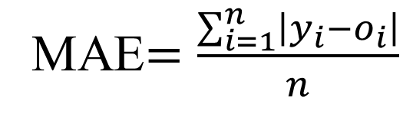
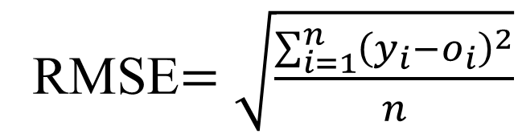
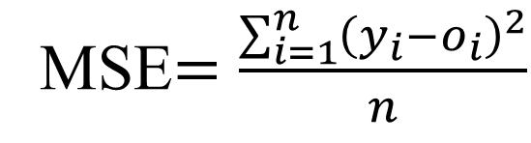
Regression Problems
Mean Absolute Error
(MAE)
Mean Squared Error
(MSE)
Root Mean Squared Error (RMSE)
MAE$=\frac{\sum_{i=1}^{n}{\left|y_{i}−o_{i}\right|}}{n}$
MSE$=\frac{\sum_{i=1}^{n}{{\left(y_{i}−o_{i}\right)}^{2}}}{n}$
RMSE$=\sqrt{\frac{\sum_{i=1}^{n}{{\left(y_{i}−o_{i}\right)}^{2}}}{n}}$

Slide 10
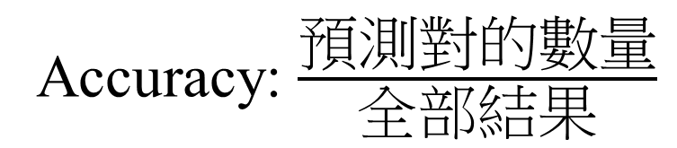
Classification Problems
Accuracy
Accuracy: $\frac{\text{預測對的數量}}{全部\text{結果}}$
e.g. predicting 6 samples
y_true = [0, 1, 3, 3, 4, 2]
y_pred = [0, 1, 3, 4, 4, 4]
Accuracy = 4/6 =66.67%

Slide 11
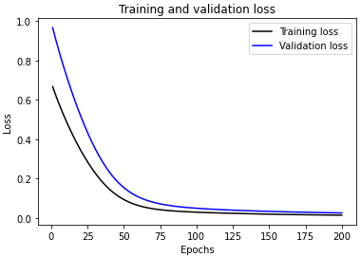
How to Build a Neural Network Model
Cross-Validation
Model
Initial
Dataset
Pre-processed
Dataset
Training
set
Neural Network
Hyperparameter optimization
80%
20%
Trained
Model
x₁ | x₂ | x₃ | y
0.1 | 0.11 | -0.11 | [1,0,0]
0.2 | 0.22 | -0.22 | [0,1,0]
0.3 | 0.33 | -0.33 | [0,0,1]
Test
set
Predicted
y values
Regression
Input
variables
Output
variables
Evaluate
Model
Performance
Mean Square Error
Classification
Accuracy

Slide 12
Data Preparation Process
Data Collection
Data Preprocessing
Data Transformation
(Feature Engineering)
Definition data required
Gathering and combining data from different sources
Formatting
Cleaning
Sampling
Scaling/normalizing
Decomposition
Aggregation

Slide 13
Feature Engineering
Feature Engineering: The process of using domain knowledge to extract features from raw data via data mining techniques
Feature Extraction
Feature Scaling
Categorical Encoding
Feature Selection
Others

Slide 14
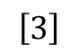
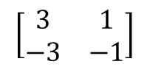
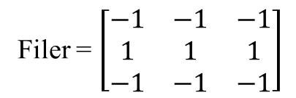
Feature Extraction
Image
Filer = $\left[\begin{matrix}−1 & −1 & −1 \\ 1 & 1 & 1 \\ −1 & −1 & −1\end{matrix}\right]$
$$\left[\begin{matrix}3 & 1 \\ −3 & −1\end{matrix}\right]$$
$$\left[3\right]$$
Convolution
Max pooling

Slide 15
Feature Extraction
Text
- Bag-of-words
- Word embedding

Slide 16
Bag-of-Words
Bag-of-words (BoW): A representation of text that describes the occurrence of words within a document
"John","likes","to","watch","movies","Mary","likes","movies","too"
"Mary","also","likes","to","watch","football","games"
BoW1 = {"John":1,"likes":2,"to":1,"watch":1,"movies":2,"Mary":1,"too":1};
BoW2 = {"Mary":1,"also":1,"likes":1,"to":1,"watch":1,"football":1,"games":1};

Slide 17
Word Embedding
Word Embedding: To map human language into a geometric space
Words
Word Vectors
1
建中
北一女
建中
[0.2,0.8]
雄中
[0.2,0.2]
雄中
雄女
北一女
[0.8,0.8]
0
1
雄女
[0.8,0.2]
The geometric relationships between word vectors should reflect the semantic relationships between these words

Slide 18
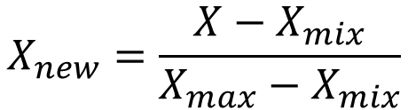
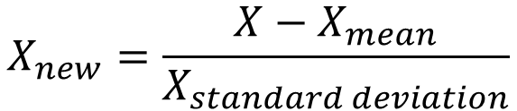
Feature Scaling
Normalization (Min-Max Scaling)
Standardization
(Z-Score Normalization)
$$X_{new}=\frac{X−X_{mix}}{X_{max}−X_{mix}}$$
$$X_{new}=\frac{X−X_{mean}}{X_{standard deviation}}$$
If the data is not scaled, deep learning algorithms that compute the distance between the features are biased towards numerically larger values
Feature scaling helps deep learning algorithms train and converge faster

Slide 19
Normalization and Standardization
Normalization | Standardization
Minimum and maximum value of features are used for scaling | Mean and standard deviation is used for scaling.
It is used when features are of different scales. | It is used when we want to ensure zero mean and unit standard deviation.
Scales values between [0, 1] or [-1, 1]. | It is not bounded to a certain range.
It is really affected by outliers. | It is much less affected by outliers.
Scikit-Learn provides a transformer called MinMaxScaler for Normalization. | Scikit-Learn provides a transformer called StandardScaler for standardization.

Slide 20
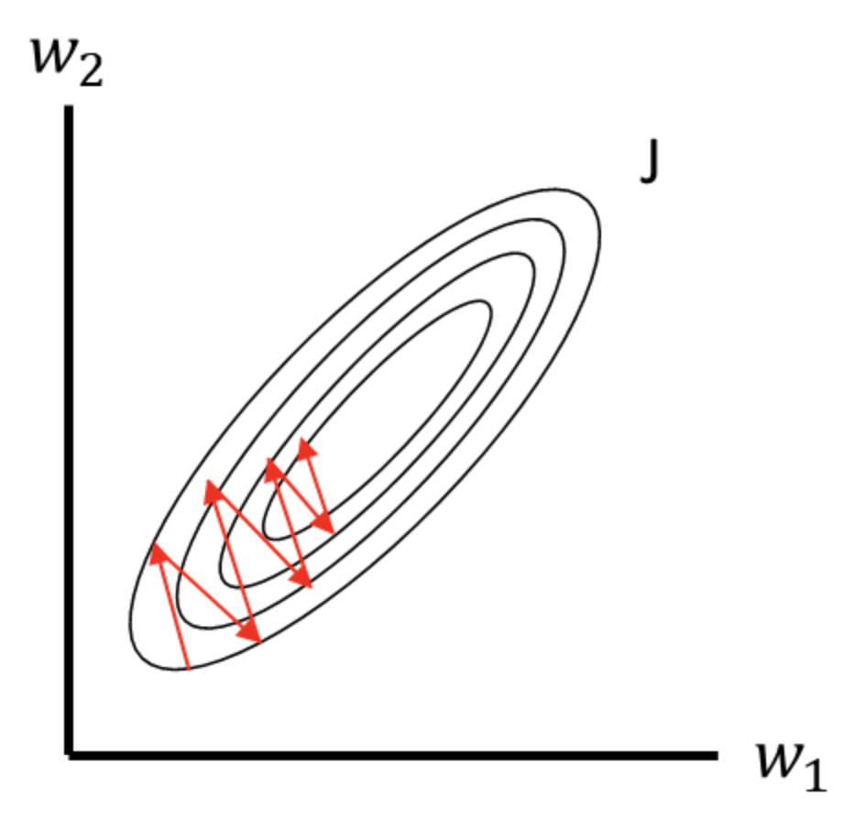

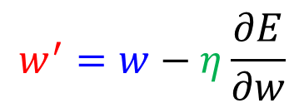
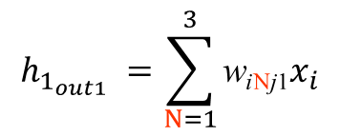
Scale-Sensitive
名稱 | 攻擊距離 | 魔力 | 魔力回復 | 魔力提升 | 生命提升 | 生命 | 生命回復 | 移動速度 | 物理攻擊 | 物理防禦 | 魔法防禦 | 類型
厄薩斯 | 175 | 0 | 0 | 0 | 90 | 580 | 3 | 345 | 60 | 38 | 32.1 | 鬥士
阿璃 | 550 | 418 | 0.8 | 25 | 92 | 526 | 6.5 | 330 | 53 | 20.9 | 30 | 法師
阿卡莉 | 125 | 200 | 0 | 0 | 95 | 575 | 8 | 345 | 62.4 | 23 | 37 | 刺客
亞歷斯塔 | 125 | 350 | 0.8 | 40 | 106 | 573.4 | 8.5 | 330 | 61.1 | 44 | 32.1 | 坦克
阿姆姆 | 125 | 287 | 0.5 | 40 | 84 | 613.1 | 9 | 335 | 53.4 | 33 | 32.1 | 坦克
i₁
j₁
魔力回復
$$h_{1_{out1}} =\sum_{N=1}^{3}{\text{w}\text{i}\text{N}\text{j}\text{1}x_{i}}$$
$$w^{′}=w−η\frac{∂E}{∂w}$$
‘生命’ is more sensitive than ‘魔力回復’
i_{m}
$$\text{j}\text{m}$$
生命
Raw Data

Slide 21
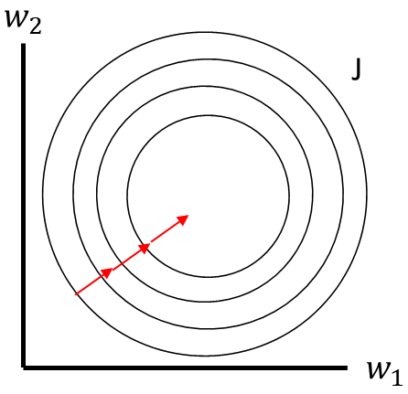
Standardization (Z-Score Normalization)
名稱 | 攻擊距離 | 魔力 | 魔力回復 | 魔力提升 | 生命提升 | 生命 | 生命回復 | 移動速度 | 物理攻擊 | 物理防禦 | 魔法防禦 | 類型
厄薩斯 | -0.770363 | -2.6834 | -2.014848 | -1.986775 | 0.221946 | 0.647642 | -2.02169 | 1.149003 | 0.101302 | 1.182062 | 0.567308 | 鬥士
阿璃 | 1.137805 | 0.938836 | 0.836489 | -0.482882 | 0.522647 | -0.799014 | -0.057272 | -0.834984 | -1.032971 | -1.363209 | -0.662524 | 法師
阿卡莉 | -1.024786 | -0.950273 | -2.014848 | -1.986775 | 0.973699 | 0.513692 | 0.794622 | 1.149003 | 0.490196 | -1.050631 | 3.436917 | 刺客
亞歷斯塔 | -1.024786 | 0.349573 | 0.836489 | 0.419453 | 2.627555 | 0.470828 | 1.065253 | -0.834984 | 0.279545 | 2.075139 | 0.567308 | 坦克
阿姆姆 | -1.024786 | -0.196362 | -0.232762 | 0.419453 | -0.680157 | 1.534389 | 1.345884 | -0.173655 | -0.968156 | 0.437831 | 0.567308 | 坦克
Standardization
Raw Data
Normalized Data

Slide 22
Categorical Encoding
Categorical Encoding: a process of converting categories to numbers
-Integer Encoding (Label Encoding)
-One-hot Encoding

Slide 23
Label Encoding
名稱 | 攻擊距離 | 魔力 | 魔力回復 | 魔力提升 | 生命提升 | 生命 | 生命回復 | 移動速度 | 物理攻擊 | 物理防禦 | 魔法防禦 | 類型
厄薩斯 | 175 | 0 | 0 | 0 | 90 | 580 | 3 | 345 | 60 | 38 | 32.1 | 鬥士
阿璃 | 550 | 418 | 0.8 | 25 | 92 | 526 | 6.5 | 330 | 53 | 20.9 | 30 | 法師
阿卡莉 | 125 | 200 | 0 | 0 | 95 | 575 | 8 | 345 | 62.4 | 23 | 37 | 刺客
亞歷斯塔 | 125 | 350 | 0.8 | 40 | 106 | 573.4 | 8.5 | 330 | 61.1 | 44 | 32.1 | 坦克
阿姆姆 | 125 | 287 | 0.5 | 40 | 84 | 613.1 | 9 | 335 | 53.4 | 33 | 32.1 | 坦克
類型 | Label Encoding
鬥士 | [0]
法師 | [1]
刺客 | [2]
坦克 | [3]

Slide 24
One-Hot Encoding
名稱 | 攻擊距離 | 魔力 | 魔力回復 | 魔力提升 | 生命提升 | 生命 | 生命回復 | 移動速度 | 物理攻擊 | 物理防禦 | 魔法防禦 | 類型
厄薩斯 | 175 | 0 | 0 | 0 | 90 | 580 | 3 | 345 | 60 | 38 | 32.1 | 鬥士
阿璃 | 550 | 418 | 0.8 | 25 | 92 | 526 | 6.5 | 330 | 53 | 20.9 | 30 | 法師
阿卡莉 | 125 | 200 | 0 | 0 | 95 | 575 | 8 | 345 | 62.4 | 23 | 37 | 刺客
亞歷斯塔 | 125 | 350 | 0.8 | 40 | 106 | 573.4 | 8.5 | 330 | 61.1 | 44 | 32.1 | 坦克
阿姆姆 | 125 | 287 | 0.5 | 40 | 84 | 613.1 | 9 | 335 | 53.4 | 33 | 32.1 | 坦克
類型 | One-Hot Encoding
鬥士 | [1 0 0 0]
法師 | [0 1 0 0]
刺客 | [0 0 1 0]
坦克 | [0 0 0 1]

Slide 25
Word Embedding
One-hot word vectors | Word Embeddings
Sparse | Dense
High-dimensional | Lower-dimensional
Hardcoded | Learned from data

Slide 26
Choosing the Right Encoding
Label Encoding | One-Hot Encoding
The categorical feature is ordinal (e.g. age) | The categorical feature is not ordinal (e.g. name)
The number of categories is quite large as one-hot encoding can lead to high memory consumption | The number of categorical features is less so one-hot encoding can be effectively applied
蔡英文=1
韓國瑜=2
宋楚瑜=3
There is a very high probability that the model captures the relationship (蔡英文 is more similar to 韓國瑜 than to 宋楚瑜)

Slide 27
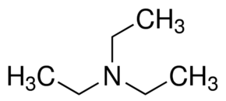
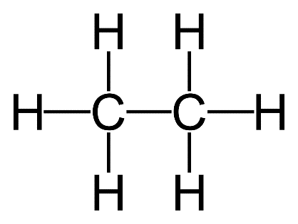
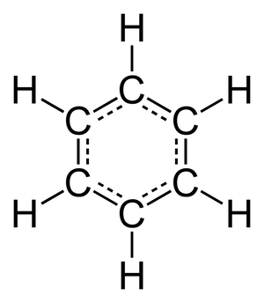
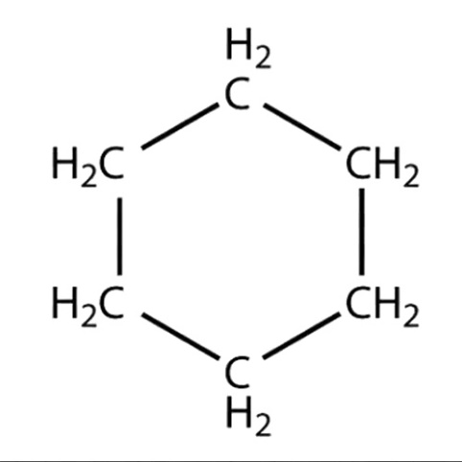
SMILES (簡化分子線性輸入法)
Simplified Mmolecular-Input line-Entry System (SMILES): A specification in the form of a line notation for describing the structure of chemical species using short ASCII strings.
CC
CCN(CC)CC
C1CCCCC1
c1ccccc1

Slide 28
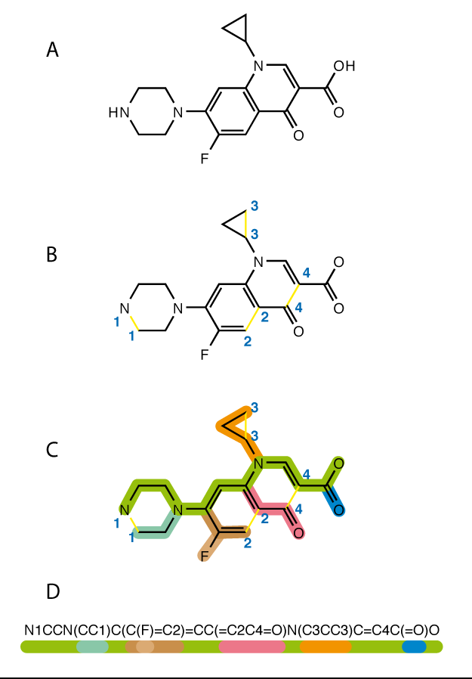
SMILES

Slide 29
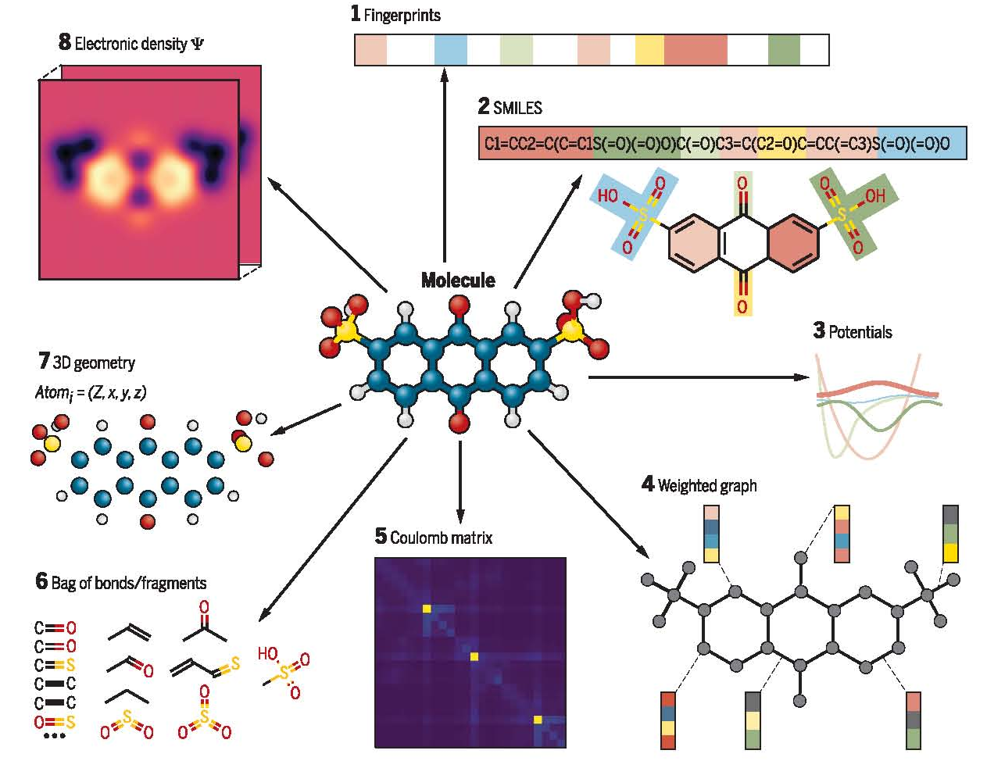
Molecular Representation for Machine Learning
Sanchez-Lengeling et al., Science 361, 360–365 (2018)

Slide 30
Model Evaluation Procedures
Train/test split
Classic evaluation
-Simple hold-out validation
-K-fold cross-validation
-Iterated K-fold cross-validation with shuffling)

Slide 31
Training, Validation, and Test Data
Data
x_train
y_train
x_valid
y_valid
x_test
y_test
0.6:0.2:0.2
0.7:0.15:0.15
0.8:0.1:0.1
Model

Slide 32
Why not have training & test sets?
Validation dataset : Tuning a hyperparameter of your model based on the model’s performance (information leaks)
Test dataset: A completely different, never-before-seen dataset

Slide 33
Classic Evaluation
Simple hold-out validation
K-fold cross-Validation
Iterated K-fold cross-validation with shuffling

Slide 34
Simple Hold-Out Validation
Total available labeled data
Training set
Validation Set
Train on this
Evaluate on this
If different random shuffling rounds of the data before splitting end up yielding very different measures of model performance

Slide 35
K-Fold Cross-Validation
Dataset
Splits into K parts
D1 | D2 | D3 | D4
Training Set
Validation Set
Fold 1
D1 | D2 | D3
D4
Evaluation 1
Fold 2
D1 | D2 | D4
D3
Evaluation 2
Average
Fold 3
D1 | D3 | D4
D2
Evaluation 3
Fold 4
D2 | D3 | D4
D1
Evaluation 4

Slide 36




Python Library for Building Neural Networks

Slide 37
Process
Input X
Layer
Layer
Predictions
Y’
True targets
Y
Loss function
Weights
Weight update
Optimization
Loss score

Slide 38
Regression in Keras
1. Define Network
model = Sequential()
model.add(Dense(96, input_dim=6, activation='relu'))
model.add(Dense(96, activation='relu'))
model.add(Dense(1))
2. Compile Network
model.compile(loss="mse", optimizer="adam", metrics=["mae"])
3. Fix Network
history = model.fit(X_train, y_train, epochs=500, batch_size=256, validation_split=0.1)
4. Evaluate Network
loss, accuracy = model.evaluate(X_test, y_test)
5. Make Predictions
predictions = model.predict(X_test)

Slide 39
Binary Classification in Keras
1. Define Network
model = Sequential()
model.add(Dense(96, input_dim=6, activation='relu'))
model.add(Dense(96, activation='relu'))
model.add(Dense(1))
2. Compile Network
model.compile(loss="binary_crossentropy", optimizer="adam", metrics=["accuracy"])
3. Fix Network
history = model.fit(X_train, y_train, epochs=500, batch_size=256, validation_split=0.1)
4. Evaluate Network
loss, accuracy = model.evaluate(X_test, y_test)
5. Make Predictions
predictions = model.predict(X_test)

Slide 40
Multiclass Classification in Keras
1. Define Network
model = Sequential()
model.add(Dense(96, input_dim=6, activation='relu'))
model.add(Dense(96, activation='relu'))
model.add(Dense(1))
2. Compile Network
model.compile(loss="categoricalcrossentropy", optimizer="adam", metrics=["accuracy"])
3. Fix Network
history = model.fit(X_train, y_train, epochs=500, batch_size=256, validation_split=0.1)
4. Evaluate Network
loss, accuracy = model.evaluate(X_test, y_test)
5. Make Predictions
predictions = model.predict(X_test)

Slide 41
Epoch
1 epoch
step
batch_size
batch_size
batch_size
Data

Slide 42
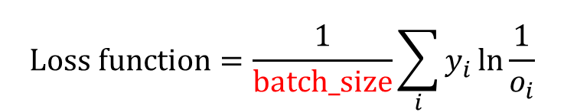
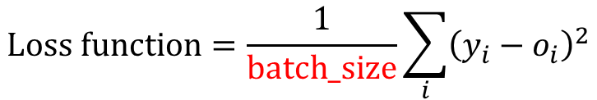
Effect of Batch Size on Neural Net Training
Theory says that, bigger the batch size, lesser is the noise in the gradients and so better is the gradient estimate. This allows the model to take a better step towards a minima. However, the challenge is that bigger batch size needs more memory and each step is time consuming.
$$Loss function=\frac{1}{batch_size}\sum_{i}{y_{i}\ln{\frac{1}{o_{i}}}}$$
$$Loss function=\frac{1}{batch_size}\sum_{i}{{\left(y_{i}−o_{i}\right)}^{2}}$$
Keeping the batch size small makes the gradient estimate noisy which might allow us to bypass a local optimum during convergence. But having very small batch size would be too noisy for the model to convergence anywhere.
In general smaller or larger batch size doesn't guarantee better convergence. Batch size is more or less treated as a hyperparameter to tune keeping in the memory constraints you have.

Slide 43


Example 1
名稱 | 攻擊距離 | 魔力 | 魔力回復 | 魔力提升 | 生命提升 | 生命 | 生命回復 | 移動速度 | 物理攻擊 | 物理防禦 | 魔法防禦 | 類型
厄薩斯 | 175 | 0 | 0 | 0 | 90 | 580 | 3 | 345 | 60 | 38 | 32.1 | 鬥士
阿璃 | 550 | 418 | 0.8 | 25 | 92 | 526 | 6.5 | 330 | 53 | 20.9 | 30 | 法師
阿卡莉 | 125 | 200 | 0 | 0 | 95 | 575 | 8 | 345 | 62.4 | 23 | 37 | 刺客
亞歷斯塔 | 125 | 350 | 0.8 | 40 | 106 | 573.4 | 8.5 | 330 | 61.1 | 44 | 32.1 | 坦克
阿姆姆 | 125 | 287 | 0.5 | 40 | 84 | 613.1 | 9 | 335 | 53.4 | 33 | 32.1 | 坦克
攻擊距離
i₁
j₁
魔力
k₁
鬥士
魔力回復
147 data
11 feature
6 output classes
Multiclass classification
法師
魔力提升
生命提升
刺客
Input
生命
Predict
生命回復
坦克
移動速度
$$\text{k}\text{m}$$
射手
物理攻擊
物理防禦
i_{m}
$$\text{j}\text{m}$$
輔助
魔法防禦

Slide 44
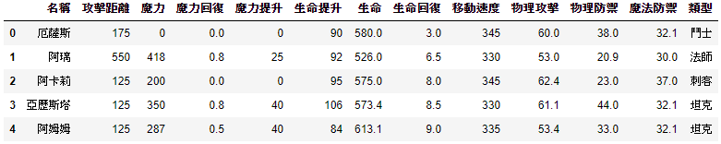
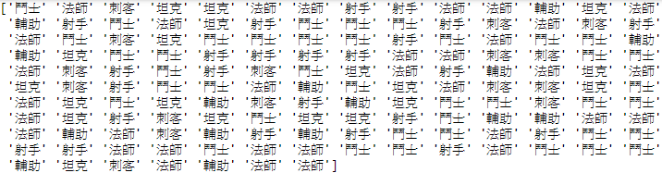
Read Excel
>>> import pandas as pd
>>> df = pd.read_excel('LOL.xlsx')
>>> df.head()
>>> Label = df['類型'].values
>>> X_train = df.drop(columns=['名稱','類型’])

Slide 45
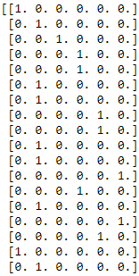
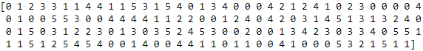
From Label Encoding to One-Hot Encoding
>>> for i in range(Label.shape[0]):
>>> if Label[i] == '鬥士':
>>> Label[i] = 0
>>> elif Label[i] == '法師':
>>> Label[i] = 1
>>> elif Label[i] == '刺客':
>>> Label[i] = 2
>>> elif Label[i] == '坦克':
>>> Label[i] = 3
>>> elif Label[i] == '射手':
>>> Label[i] = 4
>>> elif Label[i] == '輔助':
>>> Label[i] = 5
>>> from keras.utils.np_utils import to_categorical
>>> y_train = to_categorical(Label)

Slide 46
Standardization and Building a Neural Network
>>> mean = X_train.mean(axis=0)
>>> std = X_train.std(axis=0)
>>> X_train = (X_train - mean) / std
>>> from keras.models import Sequential
>>> from keras.layers import Dense
>>> model = Sequential()
>>> model.add(Dense(100, input_dim=11, activation='relu'))
>>> model.add(Dense(6, activation='softmax'))
>>> model.compile(loss="categorical_crossentropy", optimizer="adam", metrics=["accuracy"])
>>> history = model.fit(X_train, y_train, epochs=2000, batch_size=128, validation_split=0.4)

Slide 47
history_dict.keys()
>>> import matplotlib.pyplot as plt
>>> history_dict = history.history
>>> print(history_dict.keys())
Version 1: dict_keys(['val_loss', 'val_acc', 'loss', 'acc’])
Version 2: dict_keys(['val_loss', 'val_accuracy', 'loss', 'accuracy'])
>>> loss_values = history_dict['acc']
>>> val_loss_values = history_dict['val_acc']
>>> #loss_values = history_dict['accuracy']
>>> #val_loss_values = history_dict['val_accuracy']

Slide 48
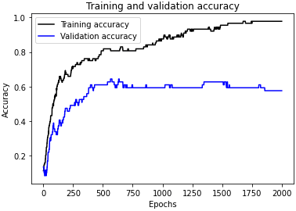
Plotting Training and Validation Loss
>>> epochs = range(1, len(loss_values) + 1)
>>> plt.plot(epochs, loss_values, 'b', color='k', label='Training accuracy')
>>> plt.plot(epochs, val_loss_values, 'b', color='b', label='Validation accuracy')
>>> plt.title('Training and validation accuracy')
>>> plt.xlabel('Epochs')
>>> plt.ylabel('Accuracy')
>>> plt.legend()
>>> plt.show()
Overfitting!!!

Slide 49


Feature Selection
Selection: Choosing a subset of the original pool of features
Feature只選攻擊距離跟魔力、Label只選鬥士、法師跟射手 (147 data, 11 feature, 3 output classes)

Slide 50

Read Excel
>>> import pandas as pd
>>> df = pd.read_excel('LOL.xlsx')
>>> df.head()
>>> df = df[(df['類型'].isin(['鬥士','法師','射手']))]
>>> Label = df['類型'].values
>>> X_train = df.drop(columns=['名稱','魔力回復','魔力提升','生命提升','生命','生命回復',
'移動速度','物理攻擊','物理防禦','魔法防禦','類型'])

Slide 51

From Label Encoding to One-Hot Encoding
>>> for i in range(Label.shape[0]):
>>> if Label[i] == '鬥士':
>>> Label[i] = 0
>>> elif Label[i] == '法師':
>>> Label[i] = 1
>>> elif Label[i] == '射手':
>>> Label[i] = 2
>>> from keras.utils.np_utils import to_categorical
>>> y_train = to_categorical(Label)

Slide 52
Standardization and Building a Neural Network
>>> mean = X_train.mean(axis=0)
>>> std = X_train.std(axis=0)
>>> X_train = (X_train - mean) / std
>>> from keras.models import Sequential
>>> from keras.layers import Dense
>>> model = Sequential()
>>> model.add(Dense(100, input_dim=2, activation='relu'))
>>> model.add(Dense(3, activation='softmax'))
>>> model.compile(loss="categorical_crossentropy", optimizer="adam", metrics=["accuracy"])
>>> history = model.fit(X_train, y_train, epochs=2000, batch_size=128, validation_split=0.4)

Slide 53
history_dict.keys()
>>> import matplotlib.pyplot as plt
>>> history_dict = history.history
>>> print(history_dict.keys())
Version 1: dict_keys(['val_loss', 'val_acc', 'loss', 'acc’])
Version 2: dict_keys(['val_loss', 'val_accuracy', 'loss', 'accuracy'])
>>> loss_values = history_dict['acc']
>>> val_loss_values = history_dict['val_acc']
>>> #loss_values = history_dict['accuracy']
>>> #val_loss_values = history_dict['val_accuracy']

Slide 54

Plotting Training and Validation Loss
>>> epochs = range(1, len(loss_values) + 1)
>>> plt.plot(epochs, loss_values, 'b', color='k', label='Training accuracy')
>>> plt.plot(epochs, val_loss_values, 'b', color='b', label='Validation accuracy')
>>> plt.title('Training and validation accuracy')
>>> plt.xlabel('Epochs')
>>> plt.ylabel('Accuracy')
>>> plt.legend()
>>> plt.show()

Slide 55
Sufficiently Large Intermediate Layers
Final outputs are 6-dimensional, you should avoid intermediate layers with many fewer than 6 hidden units.
The network is able to cram most of the necessary information into the small dimensional representations, but not all of it.

Slide 56

Further Experiments
取消Standardization或改用Min-Max Scaling
改變batch_size大小
增加神經元或層數
隱藏層神經元小於輸出層神經元
改變optimizer，例如RMSProp或下面的SGD
>>> from keras import optimizers
>>> sgd = optimizers.SGD(lr=0.01) #也可以順便改變learning rate
>>> model.compile(loss="categorical_crossentropy", optimizer=sgd, metrics=["accuracy"])
Feature改成"攻擊距離"跟"魔力回復"
$$X_{new}=\frac{X−X_{mix}}{X_{max}−X_{mix}}$$

Slide 57
Shallow Neural Network
Shallow Neural Network (SNN): One input and one output layer, and at most one hidden layer in between
Deep Neural Networks (DNN): More than one hidden layer of activation functions.
Shallow neural networks also suffer from the problem of overfitting [1,2], although probably not as much as deep learning.
[1] G. Geman, E. Bienenstock, R. Doursat, Neural networks and the bias/variance dilemma. Neural Comput., 4 (1992), pp. 1-58
[2] S. Haykin, Neural Networks. A Comprehensive Foundation. Macmillan College Publishing Co., New York, USA (1999)

Slide 58
Shallow vs. Deep
Shallow Neural Network | Deep Neural Network
More efficient to train | Challenging to train
Simpler structural decision | Sophisticated structural decision
The idea of having more layers is to extract more finer features of the input vector . So generally as we increase the depth of the model we increase the power of the model at the cost of the computational complexity .

Slide 59
Visualizing what convnets learn
First convolution layer
Second convolution layer

Slide 60
Visualizing what convnets learn
Third convolution layer

Slide 61
Visualizing what convnets learn
Forth convolution layer

Slide 62

Non-convex Optimization Problem
Loss function for deep neural networks is highly non-convex and includes many local minima, plateaus and saddle points.
Theory and experiments suggest that for high dimensional deep models, value of loss function at most local minima is close to value of loss function at global minimum. [ref]
Most local minima are good local minima!
Loss
local minima
w
Loss
w_{j}
saddle points
Loss
plateaus
w
w_{i}

Slide 63


Learning Rate and Weight Initialization
Training deep neural networks with tens of layers is challenging as they can be sensitive to the initial random weights and configuration of the learning algorithm.
Weight Initialization Method
Pre-training
Random initialization
Xavier initialization
He initialization
$$w^{′}=w−η\frac{∂E}{∂w}$$
w_{initial}
Loss
𝜂
Regularization
L1, L2
Dropout
Others
Optimization Algorithm
RMSprop
Adam
Others
$$w^{′}$$
w

Slide 64
Pre-training
Auto-encoder

Slide 65
Random Initialization
Activation function: tanh
Normal distribution
Vanishing gradient

Slide 66
Xavier Initialization
nᵢ: The number of incoming network connections (fan-in)
nᵢ₊₁:The number of outgoing network connections from that layer (fan-out)
Good for tanh!!!
Maintaining near identical variances of its weight gradients across layers

Slide 67
He Initialization
Xavier (Glorot) Initialization isn’t quite as optimal for ReLU functions
Solve
Only one tiny adjustment of Xavier (Glorot) Initialization, which is to multiply the variance of the weights by 2!

Slide 68

Different Activation Functions

Slide 69

Underfitting and Overfitting
Underfitting
Overfitting
Solving:
Reducing the network’s size
Adding weight regularization
Adding dropout (0.2-0.5)
Batch Normalization

Slide 70




L2 Regularization
$$Loss function=E+\frac{α}{2}\sum_{i=1}^{n\left[l−1\right]}{\sum_{j=1}^{n\left[l\right]}{{\left(w_{ij}^{\left[l\right]}\right)}^{2}}}$$
$${\left\|w^{\left[l\right]}\right\|}^{2}=\sum_{i=1}^{n\left[l−1\right]}{\sum_{j=1}^{n\left[l\right]}{{\left(w_{ij}^{\left[l\right]}\right)}^{2}}}:$$
Frobenius Norm
α: weight decay
Target
$$w^{′}=w−η\frac{∂E}{∂w}−α\sum_{i=1}^{n\left[l−1\right]}{\sum_{j=1}^{n\left[l\right]}{w_{ij}^{\left[l\right]}}}$$
Data

Slide 71
Dropout Regularization
Prohibit the neurons from relying only on certain features,
and therefore the weights are spread out

Slide 72





















Batch Normalization
Input
$$h_{1}$$
$$σ$$
$$h_{2}$$
Output
$$j_{1}^{I}=\frac{j_{1}−μ}{σ}$$
i₁
j₁
$$j_{1}^{′}$$
$$j_{1}^{II}=j_{1}^{I} γ+β$$
k₁
l₁
$$σ$$
$$j_{2}^{I}=\frac{j_{2}−μ}{σ}$$
$$j_{2}^{II}=j_{2}^{I} γ+β$$
i₂
$$\text{j}\text{2}$$
$$j_{2}^{′}$$
k₂
l₂
$$σ$$
$$j_{3}^{I}=\frac{j_{3}−μ}{σ}$$
$$j_{3}^{II}=j_{3}^{I} γ+β$$
i₃
$$\text{j}\text{3}$$
$$j_{3}^{′}$$
k₃
l₃
$$∑$$
Sigmoid
or
tanh
Softmax
$$μ=\frac{1}{3}\sum_{i=1}^{3}{j_{i}}$$
$$σ=\sqrt{\frac{1}{3}\sum_{i=1}^{3}{{\left(j_{i}−μ\right)}^{2}}}$$
不希望進去activation function的資料 mean 都是 0，標準差都是 1
$$γ,β$$

Slide 73
Advantages of Batch Normalization
Reduces internal covariant shift
Reduces the dependence of gradients on the scale of the parameters or their initial values
Regularizes the model and reduces the need for dropout, photometric distortions, local response normalization and other regularization techniques
Allows use of saturating nonlinearities and higher learning rates

Slide 74
Example 2
SMILES | logP
C[C@H]([C@@H](C)Cl)Cl | 2.3
C(C=CBr)N | 0.3
CCC(CO)Br | 1.3
[13CH3][13CH2][13CH2][13CH2][13CH2][13CH2]O | 2.0
CCCOCCP | 0.6
Partition coefficient (P): The ratio of concentrations of a compound in a mixture of two immiscible solvents at equilibrium. (e.g. water and octanol)
Chemical insights: From theory P value must turn great when a molecule is large and doesn't have many polar atoms or atomic groups (such containing O, N, P, S, Br, Cl, F an etc.) in it.
Ref: https://www.kaggle.com/vladislavkisin/tutorial-ml-in-chemistry-research-rdkit-mol2vec/data

Slide 75

Example 2-1
Num of atoms | Num of heavy atoms | Num of C atoms | Num of O atoms | Num of N atoms | Num of Cl atoms | logP
14 | 6 | 4 | 0 | 0 | 2 | 2.3
11 | 5 | 3 | 0 | 1 | 0 | 0.3
15 | 6 | 4 | 1 | 0 | 0 | 1.3
21 | 7 | 6 | 1 | 0 | 0 | 2.0
20 | 7 | 5 | 1 | 0 | 0 | 0.6
Num of atoms
Num of heavy atoms
Num of C atoms
Num of O atoms
Num of N atoms
Num of Cl atoms
i₁
j₁
14610 data
6 feature
1 output classes
Regression
Input
k₁
logP
i_{m}
$$\text{j}\text{m}$$

Slide 76
Read Excel and Count the Number of Atoms
>>> import pandas as pd
>>> df= pd.read_csv('logP_dataset.csv')
>>> df.head()
>>> from rdkit import Chem
>>> df['mol'] = df['smiles'].apply(lambda x: Chem.MolFromSmiles(x)) #SMILE轉成Mol格式
>>> df['mol'] = df['mol'].apply(lambda x: Chem.AddHs(x)) #將H原子添加到Mol
>>> df['num_of_atoms'] = df['mol'].apply(lambda x: x.GetNumAtoms()) #原子的數量
>>> df['num_of_heavy_atoms'] = df['mol'].apply(lambda x: x.GetNumHeavyAtoms()) #返回重原子數目（原子序> 1）
>>> X_train = df.drop(columns=['名稱','類型’])

Slide 77

Plotting the Number of Atom and log P
>>> import seaborn as sns
>>> sns.jointplot(df.num_of_atoms, df.logP)
>>> plt.show()
Information is not enough!!!

Slide 78
From Label Encoding to One-Hot Encoding
>>> def number_of_atoms(atom_list, df):
>>> for i in atom_list:
>>> df['num_of_{}_atoms'.format(i)] = df['mol'].apply(lambda x:len(x.GetSubstructMatches(Chem.MolFromSmiles(i))))
>>> number_of_atoms(['C','O', 'N', 'Cl'], df)
Return a tuple of tuples of positions of corresponding patterns.
To extract the number of matches we need to take the length of a corresponding tuple of tuples

Slide 79

Plotting the Number of Atom and log P
>>> sns.pairplot(df[['num_of_atoms','num_of_C_atoms','num_of_N_atoms', 'num_of_O_atoms', 'logP']], diag_kind='kde', kind='reg', markers='+')
>>> plt.show()

Slide 80
Splitting Data and Standardization
>>> train_df = df.drop(columns=['smiles', 'mol', 'logP'])
>>> y = df['logP'].values
>>> mean = train_df .mean(axis=0)
>>> std = train_df .std(axis=0)
>>> train_df = (train_df - mean) / std
>>> from sklearn.model_selection import train_test_split
>>> X_train, X_test, y_train, y_test = train_test_split(train_df , y, test_size=.1, random_state=1)

Slide 81
Building a Neural Network
>>> from keras.models import Sequential
>>> from keras.layers import Dense
>>> model = Sequential()
>>> model.add(Dense(96, input_dim=6, activation='relu'))
>>> model.add(Dense(96, activation= 'relu'))
>>> model.add(Dense(1))
>>> model.summary()
>>> model.compile(loss="mse", optimizer="adam", metrics=["mae"])
>>> history = model.fit(X_train, y_train, epochs=500, batch_size=256, validation_split=0.1)

Slide 82
history_dict.keys()
>>> import matplotlib.pyplot as plt
>>> history_dict = history.history
>>> print(history_dict.keys())
Version 1: dict_keys(['val_loss', 'val_acc', 'loss', 'acc’])
Version 2: dict_keys(['val_loss', 'val_accuracy', 'loss', 'accuracy'])
>>> loss_values = history_dict['acc']
>>> val_loss_values = history_dict['val_acc']
>>> #loss_values = history_dict['accuracy']
>>> #val_loss_values = history_dict['val_accuracy']

Slide 83

Plotting Training and Validation Loss
>>> epochs = range(1, len(loss_values) + 1)
>>> plt.plot(epochs, loss_values, 'b', color='k', label='Training accuracy')
>>> plt.plot(epochs, val_loss_values, 'b', color='b', label='Validation accuracy')
>>> plt.title('Training and validation accuracy')
>>> plt.xlabel('Epochs')
>>> plt.ylabel('Accuracy')
>>> plt.legend()
>>> plt.show()
Overfitting!!!

Slide 84
Building a Neural Network with Dropout
>>> from keras.models import Sequential
>>> from keras.layers import Dense
>>> model = Sequential()
>>> model.add(Dense(96, input_dim=6, activation='relu'))
>>> model.add(Dropout(0.5))
>>> model.add(Dense(96, activation= 'relu'))
>>> model.add(Dropout(0.5))
>>> model.add(Dense(1))
>>> model.summary()
>>> model.compile(loss="mse", optimizer="adam", metrics=["mae"])
>>> history = model.fit(X_train, y_train, epochs=500, batch_size=256, validation_split=0.1)

Slide 85

Plotting Training and Validation Loss
>>> epochs = range(1, len(loss_values) + 1)
>>> plt.plot(epochs, loss_values, 'b', color='k', label='Training accuracy')
>>> plt.plot(epochs, val_loss_values, 'b', color='b', label='Validation accuracy')
>>> plt.title('Training and validation accuracy')
>>> plt.xlabel('Epochs')
>>> plt.ylabel('Accuracy')
>>> plt.legend()
>>> plt.show()
Perfect!!!

Slide 86


Validation Higher than Training Accurracy
This happens after you use Dropout => Underfitting (high bias )
Reason: When training, a proportion of the features are set to zero (50% in your case since you're using Dropout(0.5)). When testing, all features are used (and are scaled appropriately). So the model at test time is additional robust - and might cause higher testing accuracies.
Solution:
-Try a little bit bigger network
-Try a different Deep Neural Network Architectures
-Train for a longer time
-Try using advanced optimization algorithms

Slide 87
Accuracy and Predict
Accuracy
>>> results = model.evaluate(X_test, y_test)
[0.379343104129944, 0.46965262293815613]
loss value
metrics values
Predict
>>> predictions = model.predict(X_test)

Slide 88
Further Experiments
測試一組shallow跟deep 參數量都一樣
取消Standardization或改用Min-Max Scaling
改變batch_size和epoch大小
增加神經元或層數
使用Batch Normalization
做He Initialization
>>> from tensorflow.keras import initializers
>>> initializers.he_normal(seed=None)
改變optimizer，例如RMSProp或下面的SGD
>>> from keras import optimizers
>>> sgd = optimizers.SGD(lr=0.01) #也可以順便改變learning rate
>>> model.compile(loss="categorical_crossentropy", optimizer=sgd, metrics=["accuracy"])

Slide 89

Example 2-2
SMILES | logP
C[C@H]([C@@H](C)Cl)Cl | 2.3
C(C=CBr)N | 0.3
CCC(CO)Br | 1.3
[13CH3][13CH2][13CH2][13CH2][13CH2][13CH2]O | 2.0
CCCOCCP | 0.6
C
(
C
=
C
B
r
)
N
i₁
j₁
14610 data
6 feature
1 output classes
Regression
Input
k₁
logP
i_{m}
$$\text{j}\text{m}$$

Slide 90
Dividing the SMILES into Unique Tokens
>>> from keras.preprocessing import text, sequence
>>> from keras.preprocessing.text import Tokenizer
>>> tokenizer = Tokenizer(lower=False, char_level=True)
>>> tokenizer.fit_on_texts(df.values[:,0])
>>> X = tokenizer.texts_to_sequences(df.values[:,0])
>>> X = sequence.pad_sequences(X, dtype='int32', truncating='pre', value=0., maxlen=max_length)
>>> print("word_index =", tokenizer.word_index)

Slide 91
Building a Neural Network
Tokens
Word Embedding
LSTM

Slide 92

Plotting Training and Validation Loss
>>> epochs = range(1, len(loss_values) + 1)
>>> plt.plot(epochs, loss_values, 'b', color='k', label='Training loss')
>>> plt.plot(epochs, val_loss_values, 'b', color='b', label='Validation loss')
>>> plt.title('Training and validation loss')
>>> plt.xlabel('Epochs')
>>> plt.ylabel('Loss')
>>> plt.legend()
>>> plt.show()
Perfect!!!

Slide 93
Further Experiments
改變batch_size和epoch大小
增加神經元或層數
做Xavier Initialization
>>> from tensorflow.keras import initializers
>>> initializers.GlorotNormal(seed=None)
改變optimizer，例如RMSProp或下面的SGD
>>> from keras import optimizers
>>> sgd = optimizers.SGD(lr=0.01) #也可以順便改變learning rate
>>> model.compile(loss="categorical_crossentropy", optimizer=sgd, metrics=["accuracy"])
使用Batch Normalization
用SimpleRNN或GRU
將Br和Cl各自表示成一個token

Slide 94
Sequence Data Problem
Language Processing
e.g. Language Translator, Social Media Monitoring, Chatbots, Others.
Numerical Time Series
e.g. Biology, Medicine, Finance, Industry, Others.

Slide 95

Numerical Time Series
Weather timeseries dataset (420,551 data)
14 weather-related values (feature)
2009–2016
Recorded every 10 minutes over several years

Slide 96
Numerical Time Series
Index | Features | Description
1 | Date Time | Date-time reference
2 | p (mbar) | Pressure in millibar
3 | T (degC) | Temperature in Celsius
4 | Tpot (K) | Temperature in Kelvin
5 | Tdew (degC) | Temperature in Celsius relative to humidity
6 | rh (%) | Relative Humidity
7 | VPmax (mbar) | Saturation vapor pressure
8 | VPact (mbar) | Vapor pressure
9 | VPdef (mbar) | Vapor pressure deficit
10 | sh (g/kg) | Specific humidity
11 | H2OC (mmol/mol) | Water vapor concentration
12 | rho (g/m ** 3) | Airtight
13 | wv (m/s) | Wind speed
14 | max. wv (m/s) | Maximum wind speed
15 | wd (deg) | Wind direction in degrees

Slide 97

Numerical Time Series
Date Time | p (mbar) | T (degC) | Tpot (K) | Tdew (degC) | rh (%) | VPmax (mbar) | VPact (mbar) | VPdef (mbar) | sh (g/kg) | H2OC (mmol/mol) | rho (g/m^3) | wv (m/s) | max. wv (m/s) | wd (deg)
01.01.2009 00:10:00 | 996.52 | -8.02 | 265.4 | -8.9 | 93.3 | 3.33 | 3.11 | 0.22 | 1.94 | 3.12 | 1307.75 | 1.03 | 1.75 | 152.3
01.01.2009 00:20:00 | 996.57 | -8.41 | 265.01 | -9.28 | 93.4 | 3.23 | 3.02 | 0.21 | 1.89 | 3.03 | 1309.8 | 0.72 | 1.5 | 136.1
01.01.2009 00:30:00 | 996.53 | -8.51 | 264.91 | -9.31 | 93.9 | 3.21 | 3.01 | 0.2 | 1.88 | 3.02 | 1310.24 | 0.19 | 0.63 | 171.6
01.01.2009 00:40:00 | 996.51 | -8.31 | 265.12 | -9.07 | 94.2 | 3.26 | 3.07 | 0.19 | 1.92 | 3.08 | 1309.19 | 0.34 | 0.5 | 198
01.01.2009 00:50:00 | 996.51 | -8.27 | 265.15 | -9.04 | 94.1 | 3.27 | 3.08 | 0.19 | 1.92 | 3.09 | 1309 | 0.32 | 0.63 | 214.3
一年
十分鐘一個數據點，一年約有52560個數據點。

Slide 98

Numerical Time Series
Date Time | p (mbar) | T (degC) | Tpot (K) | Tdew (degC) | rh (%) | VPmax (mbar) | VPact (mbar) | VPdef (mbar) | sh (g/kg) | H2OC (mmol/mol) | rho (g/m^3) | wv (m/s) | max. wv (m/s) | wd (deg)
01.01.2009 00:10:00 | 996.52 | -8.02 | 265.4 | -8.9 | 93.3 | 3.33 | 3.11 | 0.22 | 1.94 | 3.12 | 1307.75 | 1.03 | 1.75 | 152.3
01.01.2009 00:20:00 | 996.57 | -8.41 | 265.01 | -9.28 | 93.4 | 3.23 | 3.02 | 0.21 | 1.89 | 3.03 | 1309.8 | 0.72 | 1.5 | 136.1
01.01.2009 00:30:00 | 996.53 | -8.51 | 264.91 | -9.31 | 93.9 | 3.21 | 3.01 | 0.2 | 1.88 | 3.02 | 1310.24 | 0.19 | 0.63 | 171.6
01.01.2009 00:40:00 | 996.51 | -8.31 | 265.12 | -9.07 | 94.2 | 3.26 | 3.07 | 0.19 | 1.92 | 3.08 | 1309.19 | 0.34 | 0.5 | 198
01.01.2009 00:50:00 | 996.51 | -8.27 | 265.15 | -9.04 | 94.1 | 3.27 | 3.08 | 0.19 | 1.92 | 3.09 | 1309 | 0.32 | 0.63 | 214.3
First 200,000 timesteps as training data
Data are sampled at one data point per hour

Slide 99

One to One
X_train[0]
Shape: (1,14)
X_train[1]
Shape: (1,14)
X_train[N-1]
Shape: (1,14)
Day 1
Day 2
Day N-1
One to One
time
feature
y_train[0]
Shape: (1,1)
y_train[1]
Shape: (1,1)
y_train[N-1]
Shape: (1,1)
Day 2
Day 3
Day N
t=1
t=2
Input shape = (N-1, 1, 14)
Output shape = (N-1, 1, 1)

Slide 100
Many to One
Day 1
X_train[0]
Shape: (10,14)
Day 2
X_train[1]
Shape: (10,14)
Day N-10
X_train[N-10]
Shape: (10,14)
Many to One
time
feature
Day 10
Day 11
Day N-1
t=1
t=10
t=11
y_train[0]
Shape: (1,1)
y_train[1]
Shape: (1,1)
y_train[N-10]
Shape: (1,1)
Day 11
Day 12
Day N
Input shape = (N-10, 10, 14)
Output shape = (N-10, 1, 1)

Slide 101
One to Many
Day 1
X_train[0]
Shape: (1,14)
Day 2
X_train[1]
Shape: (1,14)
Day N-10
X_train[N-10]
Shape: (1,14)
Day 2
y_train[0]
Shape: (10,1)
Day 3
y_train[1]
Shape: (10,1)
Day N-9
y_train[N-10]
Shape: (10,1)
time
feature
One to Many
t=1
t=2
t=11
Day 11
Day 12
Day N
Input shape = (N-10, 1, 14)
Output shape = (N-10, 10, 1)

Slide 102
Many to Many
Day 1
X_train[0]
Shape: (10,14)
Day 2
X_train[1]
Shape: (10,14)
Day N-19
X_train[N-1]
Shape: (10,14)
Many to Many
Day 11
Day N-10
Day 10
time
feature
Day 11
y_train[0]
Shape: (10,1)
Day 12
y_train[1]
Shape: (10,1)
Day N-9
y_train[N-1]
Shape: (10,1)
t=1
t=10
t=11
t=20
Day 20
Day 21
Day N
Input shape = (N-19, 10, 14)
Output shape = (N-19, 10, 1)

Slide 103
Shuffle
X_train[0]
Shape: (a,14)
X_train[1]
Shape: (a,14)
X_train[N-x]
Shape: (a,14)
y_train[0]
Shape: (b,1)
y_train[1]
Shape: (b,1)
y_train[N-1]
Shape: (b,1)
Total data

Slide 104
RNN Model
Dense (n)
One or Many
o₁
o₁
o_{t}
RNN cell
RNN cell
RNN cell
x₁
x₁
x_{t}
One or Many

Slide 105
One to One
One to One
Dense(1)
>>> model = Sequential()
>>> model.add(LSTM(10, input_length=X_train.shape[1], input_dim=X_train.shape[2]))
>>> model.add(Dense(1))
>>> model.compile(loss="mse", optimizer="adam")
time
feature

Slide 106
return_sequences and TimeDistributed
Many to One
Many to Many
Dense (1)
Dense
Dense
Dense
TimeDistributed (Dense(1))
return_sequences=False
return_sequences=True
return_sequences: Boolean. Whether to return the last output in the output sequence, or the full sequence. (default=False)
TimeDistributed: This wrapper allows to apply a layer to every temporal slice of an input.

Slide 107
return_sequences and TimeDistributed
Many to One
>>> model = Sequential()
>>> model.add(LSTM(10, input_length=X_train.shape[1], input_dim=X_train.shape[2], return_sequences=False))
>>> model.add(Dense(1))
>>> model.compile(loss="mse", optimizer="adam")
Dense
return_sequences=False

Slide 108
return_sequences and TimeDistributed
Many to Many
Dense
Dense
Dense
TimeDistributed (Dense(1))
return_sequences=True
>>> model = Sequential()
>>> model.add(LSTM(10, input_length=X_train.shape[1], input_dim=X_train.shape[2], return_sequences=True))
>>> model.add(TimeDistributed(Dense(1)))
>>> model.compile(loss="mse", optimizer="adam")

Slide 109
RepeatVector
One to Many
y₁, y₂, …, y_{n}
Dense
Dense
Dense
TimeDistributed (Dense(1))
n*o_{out}
o_{out}
o_{out}, o_{out}, …, o_{out}
RepeatVector(n)
return_sequences=False
>>> model = Sequential()
>>> model.add(LSTM(10, input_length=X_train.shape[1], input_dim=X_train.shape[2], return_sequences=False))
>>> model.add(RepeatVector(10))
>>> model.add(TimeDistributed(Dense(1)))
>>> model.compile(loss="mse", optimizer="adam")

Slide 110
Further Experiments
使用傳統DNN
改變time大小
增加或減少LSTM的unit大小，以及增加LSTM層數
做Xavier Initialization
>>> from tensorflow.keras import initializers
>>> initializers.GlorotNormal(seed=None)
改變optimizer，例如RMSProp或下面的SGD
>>> from keras import optimizers
>>> sgd = optimizers.SGD(lr=0.01) #也可以順便改變learning rate
>>> model.compile(loss="categorical_crossentropy", optimizer=sgd, metrics=["accuracy"])
使用Batch Normalization
用SimpleRNN或GRU

